Slide 1


Gym Review
Analysis
for Anlysis
01

Slide 2

Context
Answer the ‘W’
Where the problem stems from?
  Online reviews shape a gym’s reputation and customer decisions.
What is the problem?
  Identify factors that drive 1-star vs. 5-star ratings and predict review sentiment.
How do we approach the problem?
  By applying Text analytics, word clouds, topic modeling (LDA), and classification (Logistic Regression, Random Forest, XGBoost
02

Slide 3
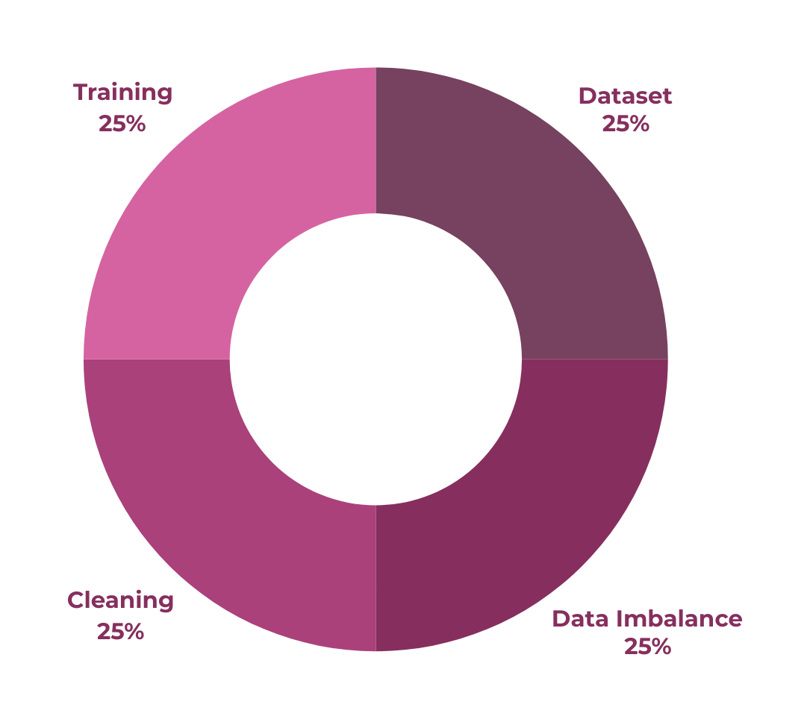
Data Overview &
Thousands of gym reviews,
with star ratings (1–5)
and review text.
Preprocessing
Training and testing
sets for classification
(e.g., 80/20).
Removed duplicates, handled
missing values, tokenized text,
removed stopwords/
punctuation
1-star and 5-star reviews dominate, fewer in 2–4 stars
03

Slide 4
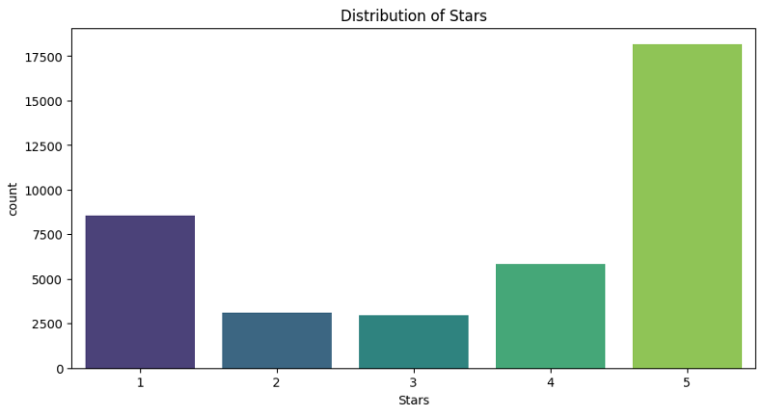
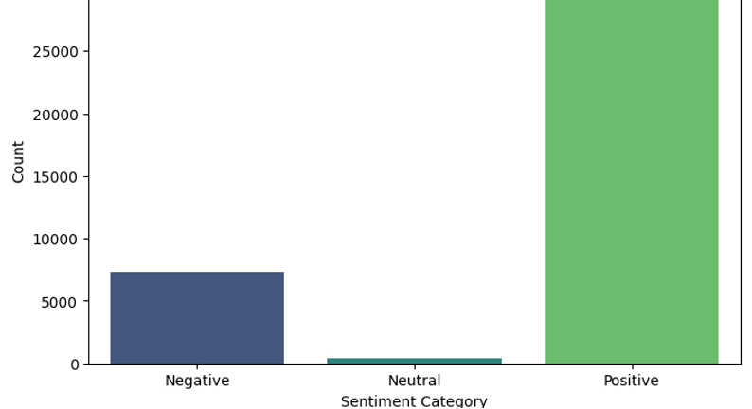

Explatory Data Analysis
Key TAkeaways
Star Rating Distribution: Large proportion of 5-star reviews,
significant 1-star chunk.
Review Length: Most are relatively short; a few are very long.
Initial Sentiment: Majority positive, fewer negative,
small neutral.
LDA Topic Exploration: Tested 2–9 topics; coherence scores
suggest fewer topics may capture main themes.
04

Slide 5
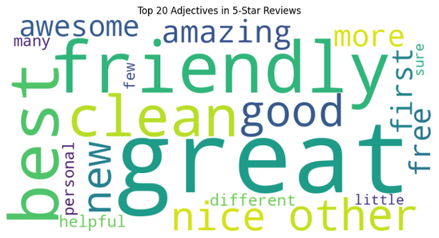
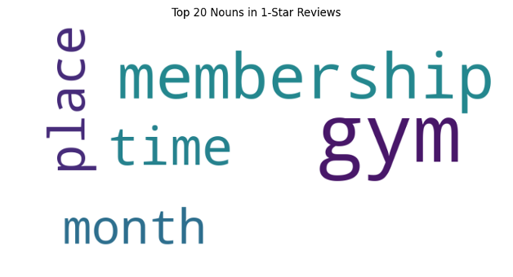
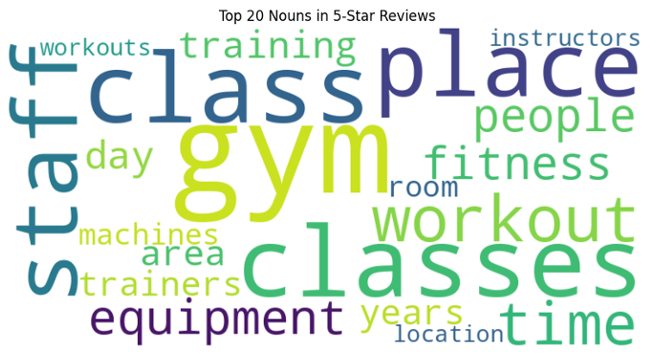
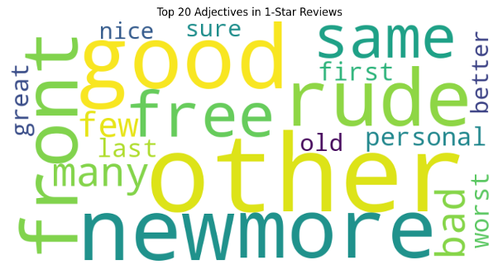
Textual Analysis
STUDIO SHODWE
Key TAkeaways
  1-Star reviews center on billing
issues, staff problems, facility concerns.
  5-Star reviews highlight positive
staff interactions, cleanliness,
and variety of classes.
  LDA reaffirms core themes
(equipment, staff, membership, etc.)
05

Slide 6

Classification Analysis
(Logistic, RF, XGBoost)
Model | Accuracy | Precision | Recall | F1 Score
Logistic Regression | 0.91 | 0.83 | 0.94 | 0.94
Random Forest | 0.89 | 0.85 | 0.81 | 0.85
XG Boost | 0.89 | 0.87 | 0.85 | 0.86
Key TAkeaway
Logistic Regression achieves the highest overall accuracy (~92%), though all models perform reasonably well on the Positive class.
06

Slide 7


Actionable
insights for Gym Owners
Negative Drivers (1-Star)
Positive Drivers (5-Star)
Recommendations
Negative Drivers (1-Star)
Billing & Contracts: Cancellation difficulties, hidden fees.
Staff & Service: Rude or unhelpful interactions.
Facility: Outdated equipment, cleanliness issues.
FriendlyStaff: Helpful, welcoming environment.
Clean, Well-Maintained Facilities: Modern equipment, tidy areas.
Class Variety: Diverse workouts, training sessions, group classes
Provide transparent contracts,
simplify cancellations.
Invest in staff
training and customer service.
Keep facilities clean and up-to-date.
7

Slide 8
Conclusion &
Future Work
Summary
1-Star reviews often cite contract/staff/equipment issues.
5-Star reviews emphasize positive staff experiences, cleanliness, and class variety.
Logistic Regression is the top performer (92% accuracy), with RF and XGBoost close behind.
Future Directions
Data Balancing: Address star rating imbalance (especially 2–4 stars).
More Topics or Larger Corpus: Refine LDA or try advanced topic modeling for deeper insights.
Real-Time Feedback: Deploy sentiment classification to track reviews continuously.
Closing
Focus on billing transparency, customer
service, and facility upgrades for
the biggest impact.
11

Slide 9
thank
you!
TeaM 110
RYAN KARIM,
SAGAR PASAD
ANWESHA BANERJEE
ZIFAN WANG
KEVIN MAREPAL
15
WWW.REALLYGREATSITE.COM

